Slide 1
INTRO TO EMBEDDED SYSTEMS WORKSHOP
Tsen Chee Vincent LEUNG YIN KO

Slide 2
AGENDA
Introduction to Embedded Systems
Hands on Workshop!
Hardware familiarization
Software familiarization
Actuators and Sensors
Demo of applications

Slide 3
WHAT ARE EMBEDDED SYSTEMS
WHAT IS IT
“Dumb” Devices
Smart Devices
Internet of Things
Robotics
WHERE IS IT
Anything “Smart”
Microwaves/Fridges
Drones/Self Driving Cars
NASA Rovers
Biochips

Slide 4
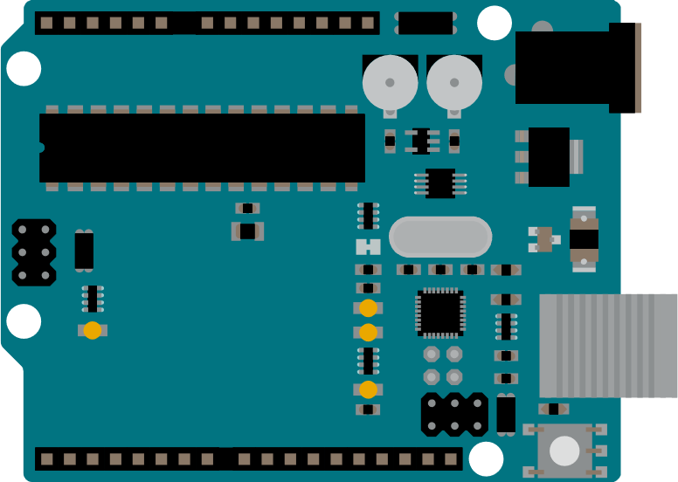

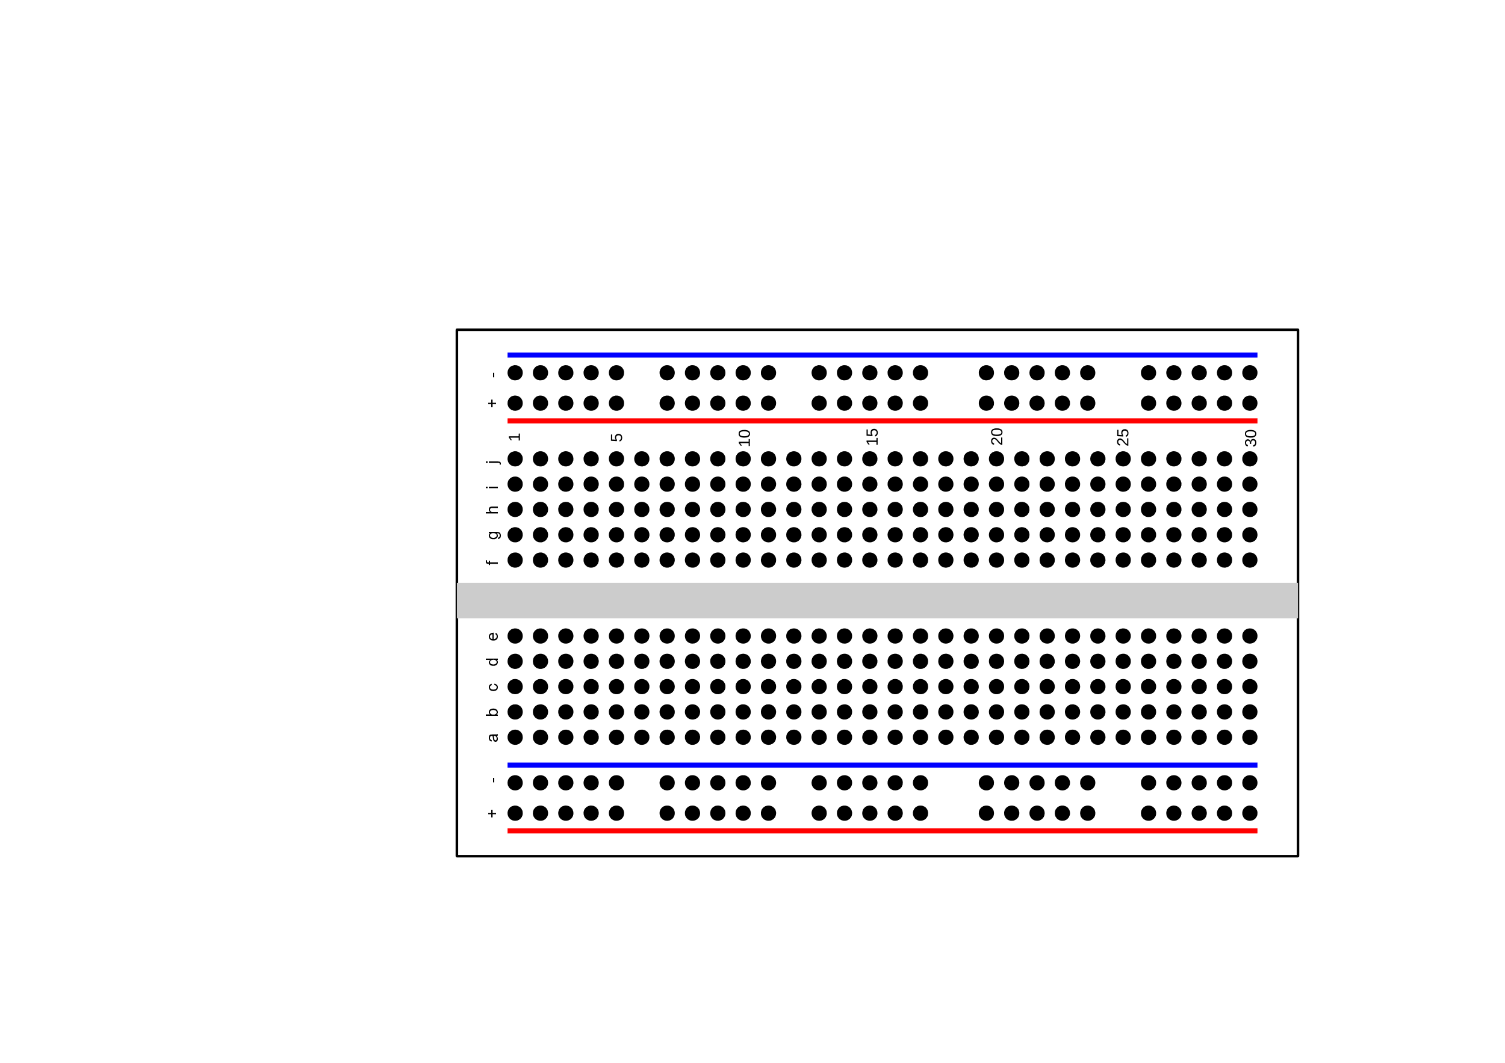
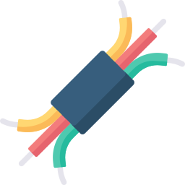

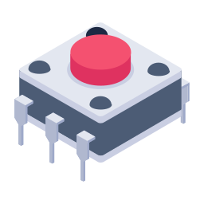
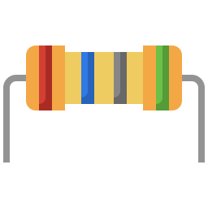

PROVIDED SUPPLIES
ARDUINO UNO/MEGA (1x)
USB CABLE (1x)
BREADBOARD (1x)
HOOKUP WIRE (1m Black, 1m Red)
LED (5x)
BUTTONS (2x)
RESISTORS (7x 330Ω, 2x 1kΩ)
CAPACITORS (2x 33nF, 2x 100nF, 2x 470μF)

Slide 5

ACTIVITY 1 SETUP THE BRAIN
Hardware
Task: Write “Hello World” on the Serial Monitor
Outcome
Microcontroller documentation
Arduino IDE Setup
Hardware + Software familiarization
Overview
☐ Arduino Datasheet
☐ Connection
☐ Arduino IDE Installation
☐ “Hello World”
☐ Flashing
☐ Serial Monitor

Slide 6
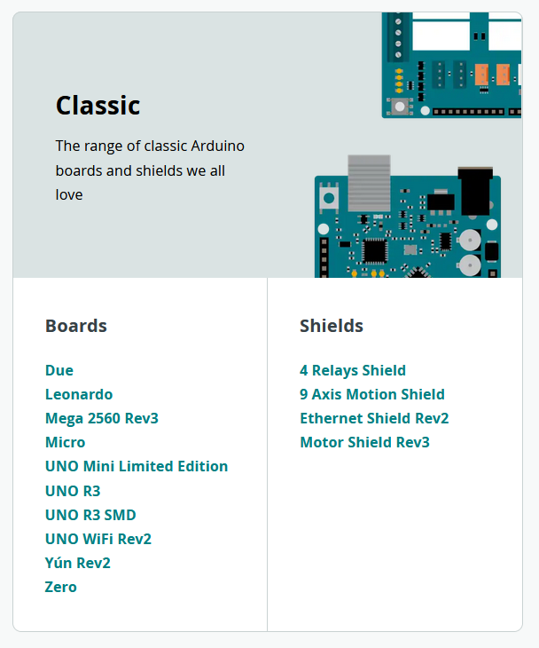
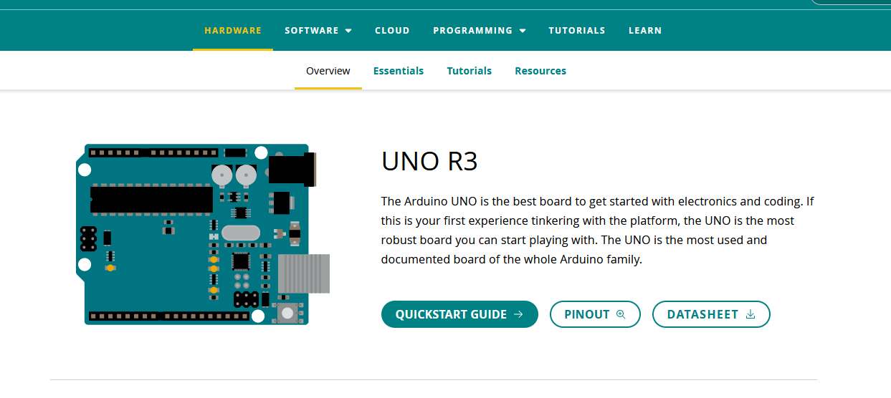
ACTIVITY 1 SETUP THE BRAIN
Download the Arduino Datasheet (https://docs.arduino.cc/hardware/uno-rev3)
Hardware
Overview
☐ Arduino Datasheet
☐ Connection
☐ Arduino IDE Installation
☐ “Hello World”
☐ Flashing
☐ Serial Monitor

Slide 7
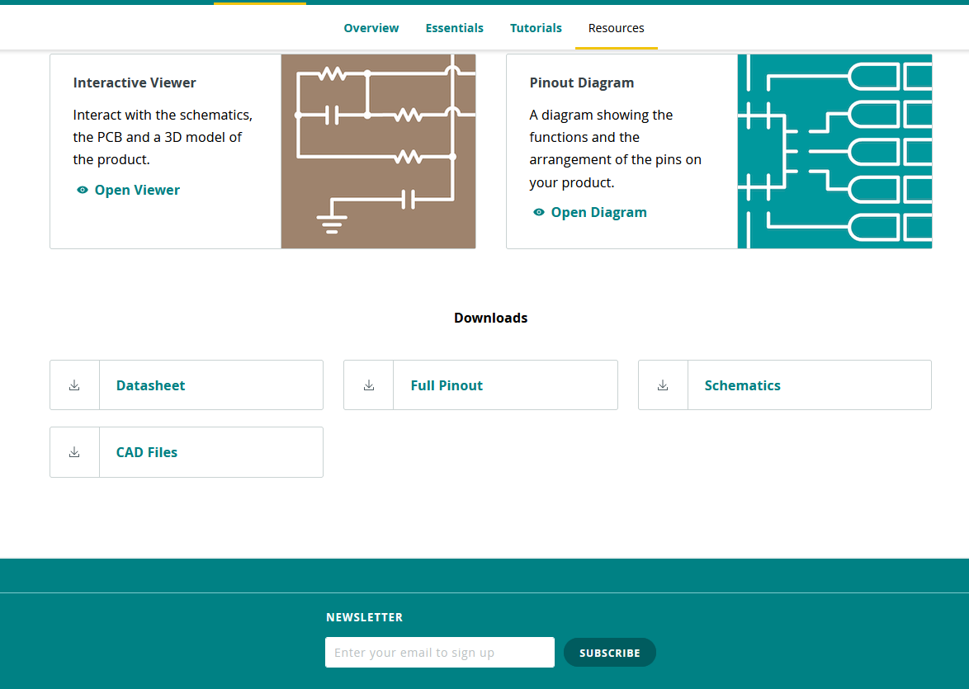
ACTIVITY 1 SETUP THE BRAIN
Download the Arduino Datasheet (https://docs.arduino.cc/hardware/uno-rev3)
Hardware
2
Overview
☐ Arduino Datasheet
☐ Connection
☐ Arduino IDE Installation
☐ “Hello World”
☐ Flashing
☐ Serial Monitor
3
4
1

Slide 8
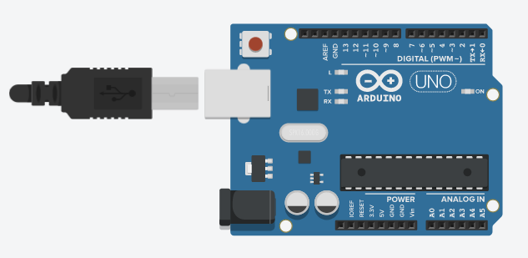
ACTIVITY 1 SETUP THE BRAIN
Connect Arduino to PC via USB Cable
Hardware
Overview
☑ Arduino Datasheet
☐ Connection
☐ Arduino IDE Installation
☐ “Hello World”
☐ Flashing
☐ Serial Monitor

Slide 9
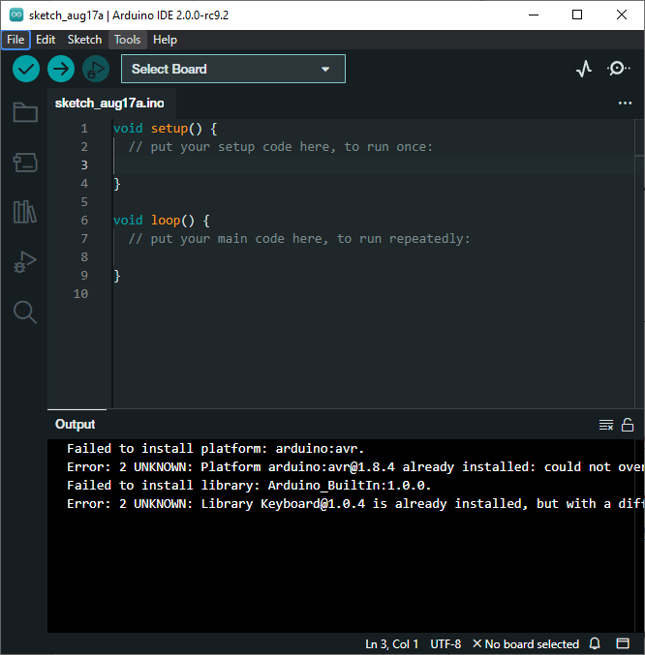
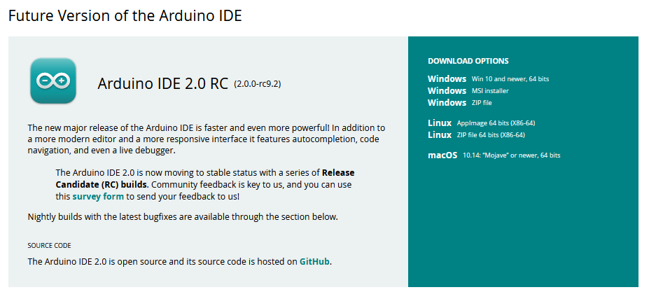
ACTIVITY 1 SETUP THE BRAIN
Download the Arduino IDE v2.x (https://docs.arduino.cc/software/ide-v2)
Install & Launch
Hardware
Overview
☑ Arduino Datasheet
☑ Connection
☐ Arduino IDE Installation
☐ “Hello World”
☐ Flashing
☐ Serial Monitor

Slide 10
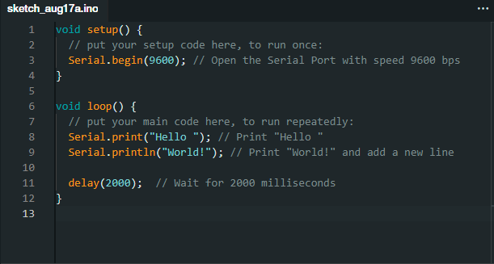
ACTIVITY 1 SETUP THE BRAIN
Code a simple “Hello World”
Hardware
Overview
☑ Arduino Datasheet
☑ Connection
☑ Arduino IDE Installation
☐ “Hello World”
☐ Flashing
☐ Serial Monitor

Slide 11
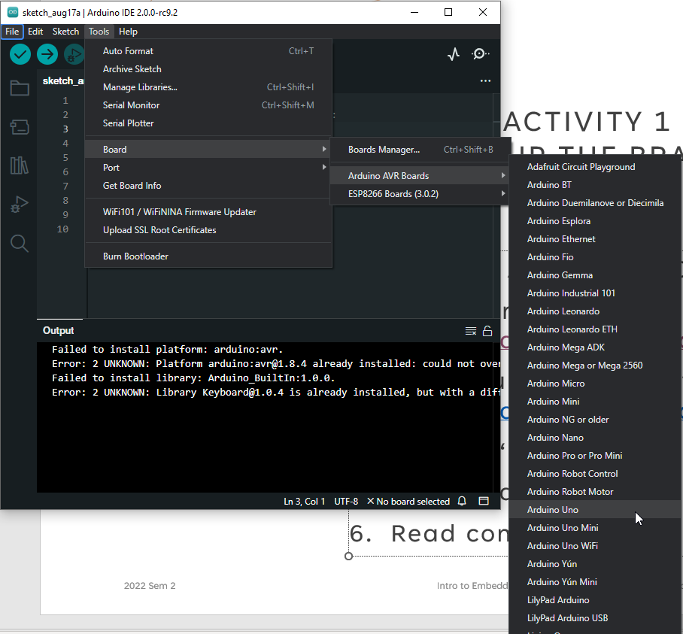
ACTIVITY 1 SETUP THE BRAIN
Tools -> Board -> Arduino AVR Boards -> Arduino Uno
Hardware
1
2
3
Overview
☑ Arduino Datasheet
☑ Connection
☑ Arduino IDE Installation
☑ “Hello World”
☐ Flashing
☐ Serial Monitor
4

Slide 12
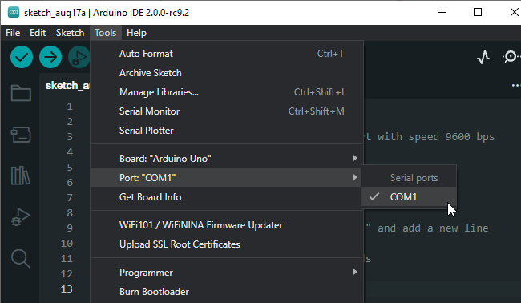
ACTIVITY 1 SETUP THE BRAIN
Tools -> Port -> COM[X]
Hardware
1
Overview
☑ Arduino Datasheet
☑ Connection
☑ Arduino IDE Installation
☑ “Hello World”
☐ Flashing
☐ Serial Monitor
2
3

Slide 13
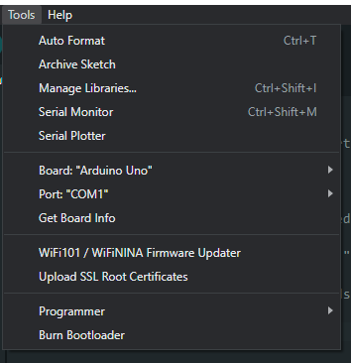
ACTIVITY 1 SETUP THE BRAIN
Board “Arduino Uno”, Port “COM[X]”
Hardware
Winning?
Overview
☑ Arduino Datasheet
☑ Connection
☑ Arduino IDE Installation
☑ “Hello World”
☐ Flashing
☐ Serial Monitor

Slide 14
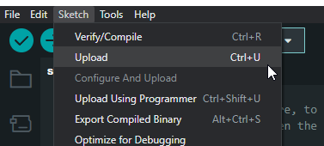
ACTIVITY 1 SETUP THE BRAIN
Flash -> Upload Files (Aka“Flashing”)
Hardware
1
2
Overview
☑ Arduino Datasheet
☑ Connection
☑ Arduino IDE Installation
☑ “Hello World”
☐ Flashing
☐ Serial Monitor

Slide 15
ACTIVITY 1 SETUP THE BRAIN
Notice output console magicks + details
Hardware
Overview
☑ Arduino Datasheet
☑ Connection
☑ Arduino IDE Installation
☑ “Hello World”
☐ Flashing
☐ Serial Monitor

Slide 16
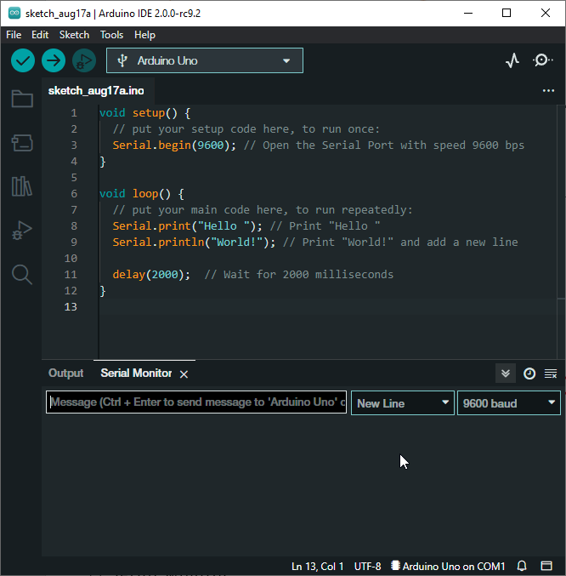
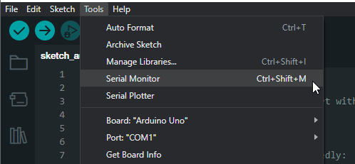
ACTIVITY 1 SETUP THE BRAIN
Tools -> Serial Monitor
What do you see?
Hardware
1
Overview
2
☑ Arduino Datasheet
☑ Connection
☑ Arduino IDE Installation
☑ “Hello World”
☑ Flashing
☐ Serial Monitor

Slide 17
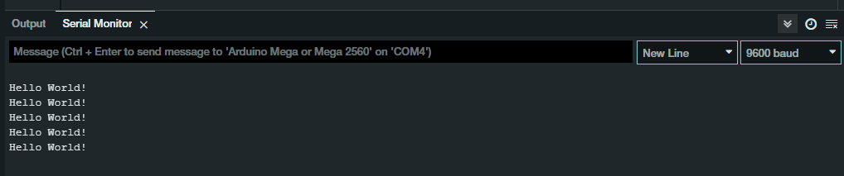
ACTIVITY 1 SETUP THE BRAIN
Tools -> Serial Monitor
What do you see? Hello World!
Hardware
Overview
☑ Arduino Datasheet
☑ Connection
☑ Arduino IDE Installation
☑ “Hello World”
☑ Flashing
☐ Serial Monitor

Slide 18
ACTIVITY 1 SETUP THE BRAIN
Hardware
Task: Write “Hello World” on the Serial Monitor
Outcome
Microcontroller documentation
Arduino IDE Setup
Hardware + Software familiarization
Recap
Arduino is a Microcontroller/the Brains
Programmable - “Flashable”
Can communicate
Overview
☑ Arduino Datasheet
☑ Connection
☑ Arduino IDE Installation
☑ “Hello World”
☑ Flashing
☑ Serial Monitor

Slide 19
ACTIVITY 2 BLINK FOR HELP
Hardware
Task: Blink the built-in LED to morse code (SOS)
Outcome
Microcontroller documentation
Hardware + Software familiarization
Output / Actuator intro
Overview
☐ Input and Output
☐ Analog/Digital GPIO
☐ Turn ON/OFF Built-in LED
☐ Blink SOS
☐ Physical Limitations (Datasheets!)

Slide 20
BREAK TIME RESUME AT:

Slide 21
ACTIVITY 2 BLINK FOR HELP
Hardware
Task: Blink the built-in LED to morse code (SOS)
Outcome
Microcontroller documentation
Hardware + Software familiarization
Output / Actuator intro
Overview
☐ Input and Output
☐ Analog/Digital GPIO
☐ Turn ON/OFF Built-in LED
☐ Blink SOS
☐ Physical Limitations (Datasheets!)

Slide 22
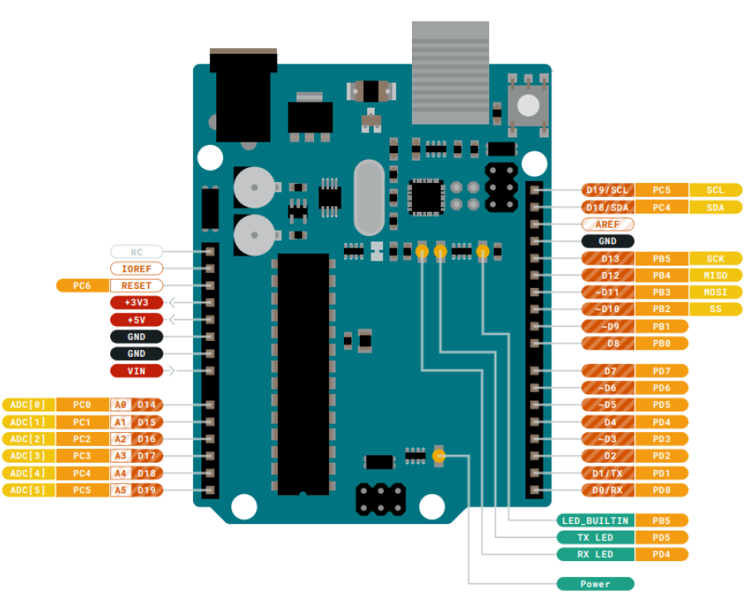
ACTIVITY 2 BLINK FOR HELP
Communication? Input? Output?
Receive? Send?
Hardware
Overview
☐ Input and Output
☐ Analog/Digital GPIO
☐ Turn ON/OFF Built-in LED
☐ Blink SOS
☐ Physical Limitations (Datasheets!)

Slide 23
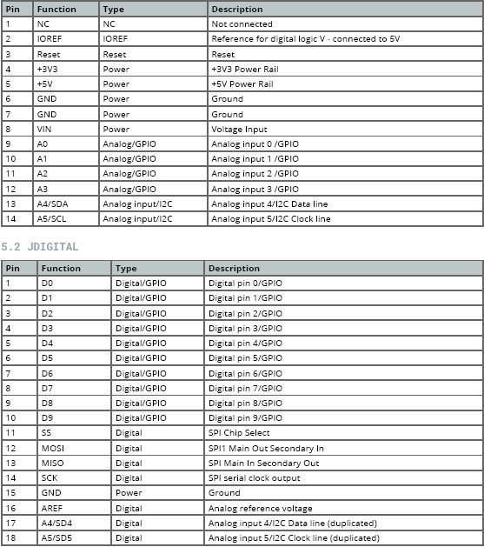
ACTIVITY 2 BLINK FOR HELP
General Purpose Input Output (GPIO)
Both Analog GPIO and Digital GPIO
Hardware
Overview
☑ Input and Output
☐ Analog/Digital GPIO
☐ Turn ON/OFF Built-in LED
☐ Blink SOS
☐ Physical Limitations (Datasheets!)

Slide 24
ACTIVITY 2 BLINK FOR HELP
Turn ON/OFF LED, Use Digital GPIO!
We’ll use “LED_BUILTIN”
Hardware
Overview
☑ Input and Output
☑ Analog/Digital GPIO
☐ Turn ON/OFF Built-in LED
☐ Blink SOS
☐ Physical Limitations (Datasheets!)

Slide 25
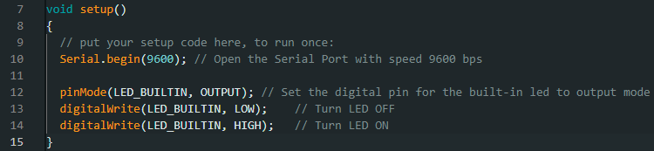
ACTIVITY 2 BLINK FOR HELP
Arduino IDE, File -> New
Set “LED_BUILTIN” to OUTPUT mode!
Turn it OFF and ON
Flash!
Hardware
Overview
☑ Input and Output
☑ Analog/Digital GPIO
☐ Turn ON/OFF Built-in LED
☐ Blink SOS
☐ Physical Limitations (Datasheets!)

Slide 26
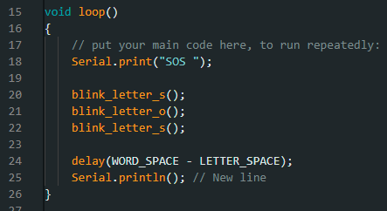
ACTIVITY 2 BLINK FOR HELP
Blink SOS morse code (· · ·---· · ·)
Use functions
Hardware
Morse Code
Dot 100ms
Dash 300ms
Between Dots and Dashes 100ms
Between Letters 300ms
Between Words 700ms
S · · ·
O ---
S · · ·
Overview
☑ Input and Output
☑ Analog/Digital GPIO
☑ Turn ON/OFF Built-in LED
☐ Blink SOS
☐ Physical Limitations (Datasheets!)

Slide 27
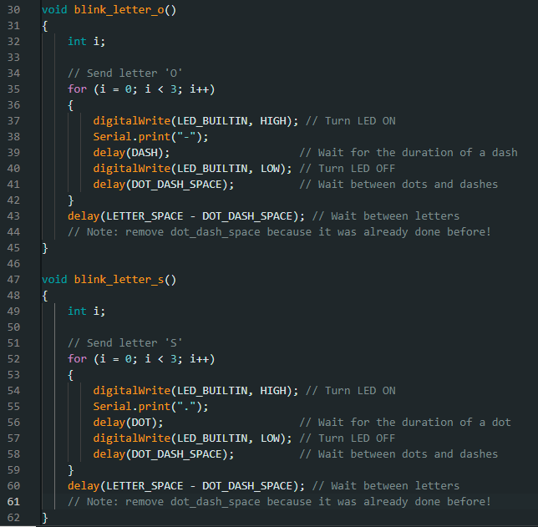
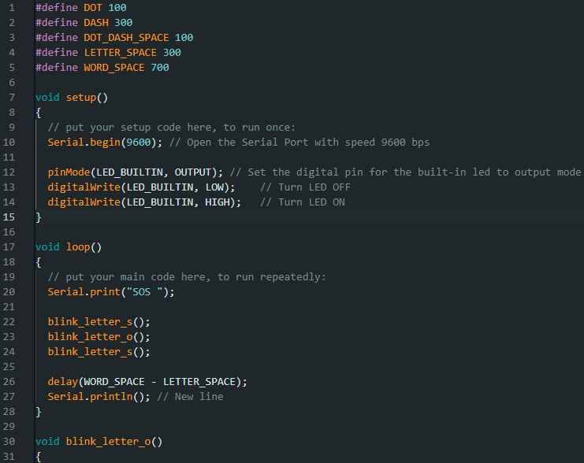
Morse Code
Dot 100ms
Dash 300ms
Between Dots and Dashes 100ms
Between Letters 300ms
Between Words 700ms
S · · ·
O ---
S · · ·
ACTIVITY 2 BLINK FOR HELP
Flash!
Hardware
Overview
☑ Input and Output
☑ Analog/Digital GPIO
☑ Turn ON/OFF Built-in LED
☐ Blink SOS
☐ Physical Limitations (Datasheets!)

Slide 28
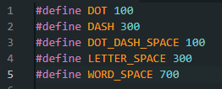
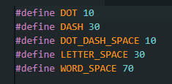
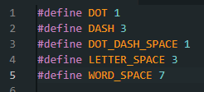
ACTIVITY 2 BLINK FOR HELP
Try reducing the time by a factor of 10x
Reduce it by a factor of 100x
Does it still blink?
Is it still bright?
Hardware
Morse Code
Dot 100ms
Dash 300ms
Between Dots and Dashes 100ms
Between Letters 300ms
Between Words 700ms
S · · ·
O ---
S · · ·
Overview
☑ Input and Output
☑ Analog/Digital GPIO
☑ Turn ON/OFF Built-in LED
☑ Blink SOS
☐ Physical Limitations (Datasheets!)

Slide 29
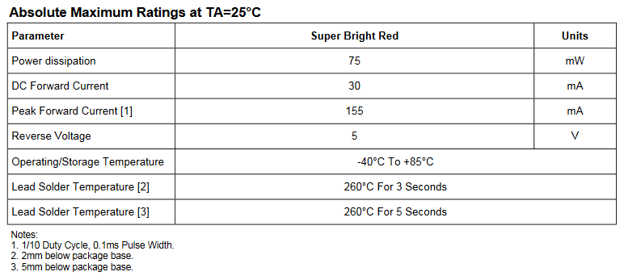
ACTIVITY 2 BLINK FOR HELP
Typical LED Datasheet
Further reading: Pulse Width Modulation (PWM)
Hardware
Overview
☑ Input and Output
☑ Analog/Digital GPIO
☑ Turn ON/OFF Built-in LED
☑ Blink SOS
☐ Physical Limitations (Datasheets!)

Slide 30
ACTIVITY 2 BLINK FOR HELP
Hardware
Task: Blink the built-in LED to morse code (SOS)
Outcome
Microcontroller documentation
Hardware + Software familiarization
Output / Actuator intro
Recap
A/O GPIO
Knowledge in documentation and/or datasheets!
Know the limitations (software and hardware)
Overview
☑ Input and Output
☑ Analog/Digital GPIO
☑ Turn ON/OFF Built-in LED
☑ Blink SOS
☑ Physical Limitations (Datasheets!)

Slide 31
ACTIVITY 3 LIGHTBRINGER
Hardware
Task: Blink an external LED to morse code (SOS) on command
Outcome
Schematic reading (basic)
Hardware + Software familiarization
Serial & Serial Monitor
Overview
☐ Connect External Hardware
☐ Modify SOS
☐ Send command via Serial

Slide 32
BREAK TIME RESUME AT:

Slide 33
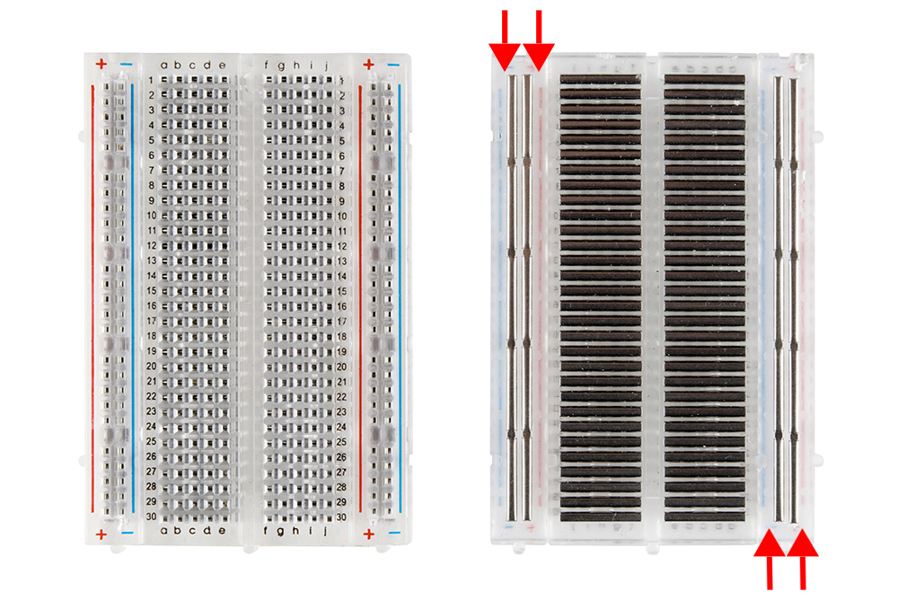
WORKING WITH ELECTRONICS
Fundamentals
Power source (AC/DC)
Voltage = Current x Resistance
Ground, Ground, Ground
If in doubt, there’s no doubt, double check & ask
Breadboard?
Build prototypes
Connect using “hookup wire”

Slide 34
ACTIVITY 3 LIGHTBRINGER
Hardware
Task: Blink an external LED to morse code (SOS) on command
Outcome
Schematic reading (basic)
Hardware + Software familiarization
Serial & Serial Monitor
Overview
☐ Connect External Hardware
☐ Modify SOS
☐ Send command via Serial

Slide 35
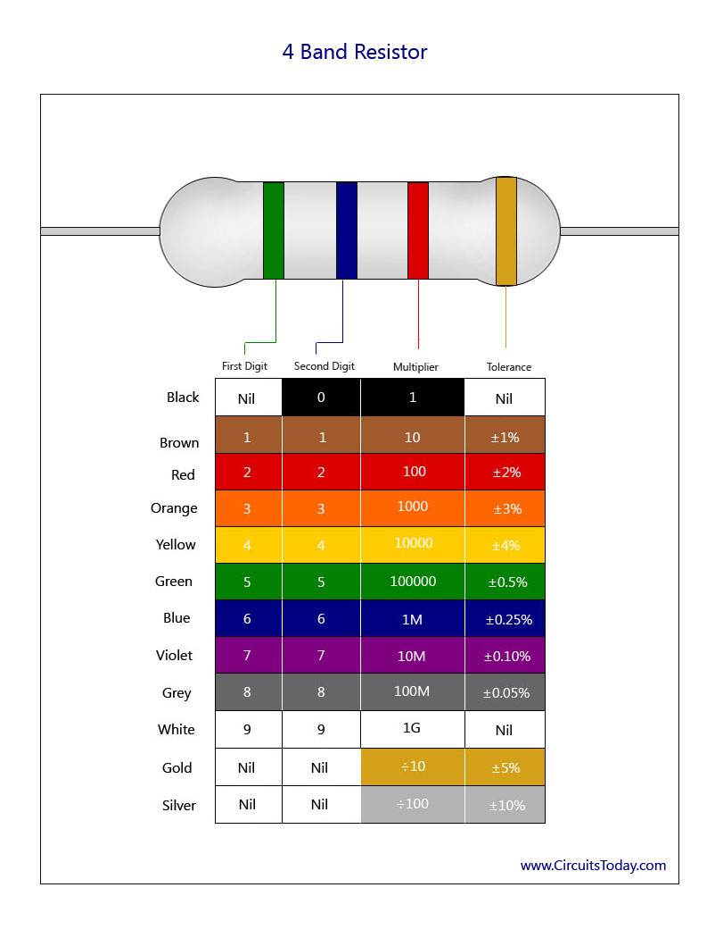
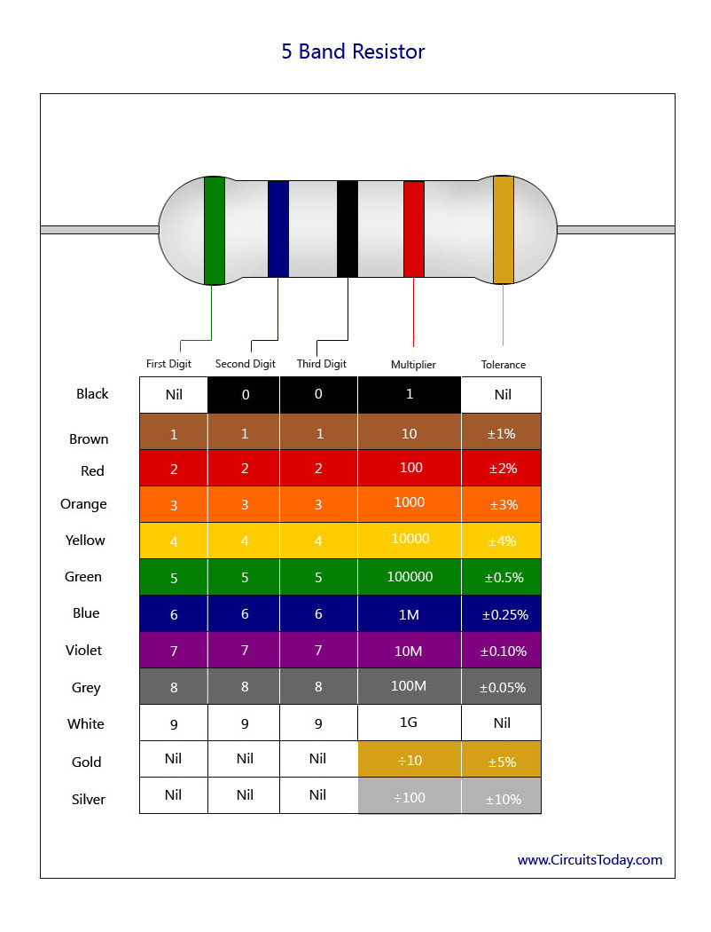
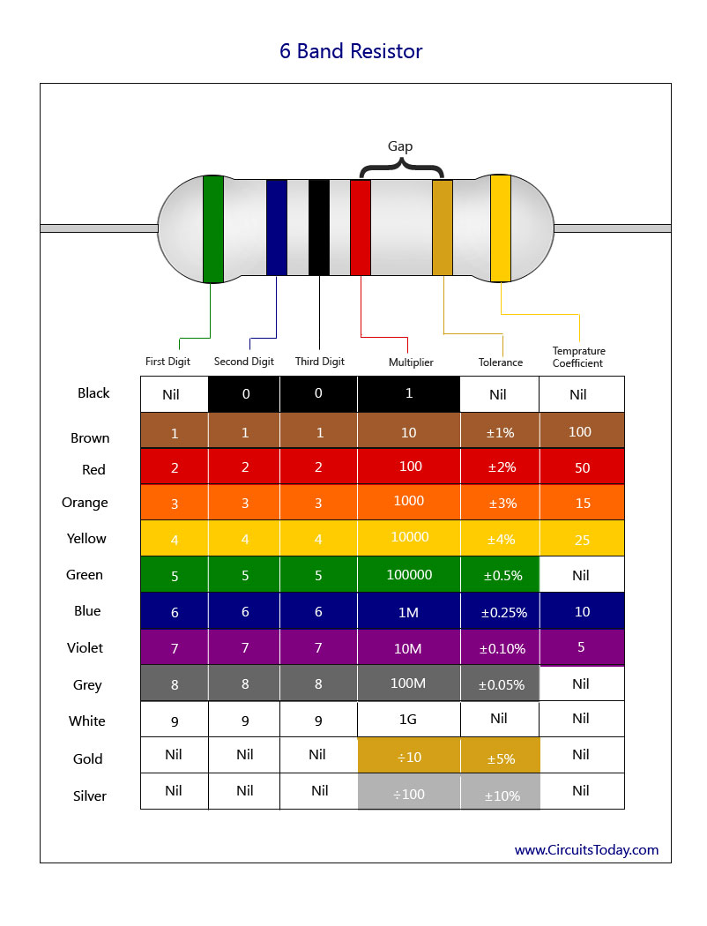
ACTIVITY 3 LIGHTBRINGER
Long – Anode
Flat – Cathode
+
-
DISCONNECT!
Hardware
Overview
☐ Connect External Hardware
☐ Modify SOS
☐ Send command via Serial

Slide 36
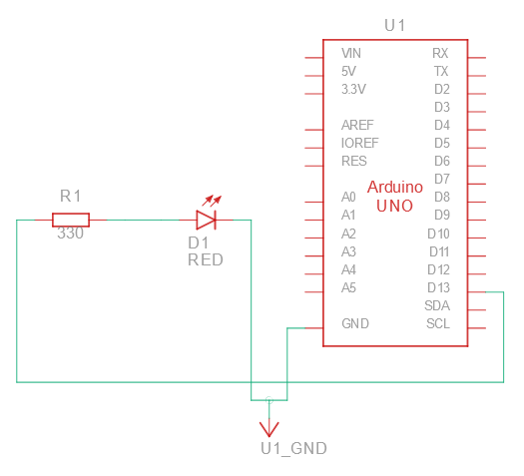
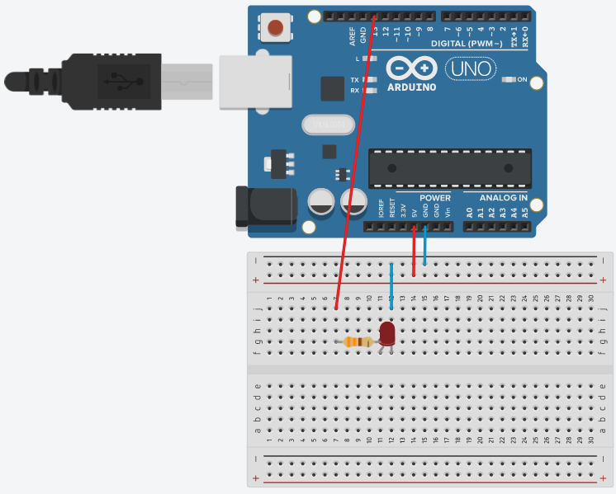
ACTIVITY 3 LIGHTBRINGER
Long – Anode
Flat – Cathode
+
-
Wire as per schematic
Hardware
Overview
☐ Connect External Hardware
☐ Modify SOS
☐ Send command via Serial

Slide 37
ACTIVITY 3 LIGHTBRINGER
Hardware
Wiring Check
Overview
☐ Connect External Hardware
☐ Modify SOS
☐ Send command via Serial
Long – Anode
Flat – Cathode
+
-

Slide 38
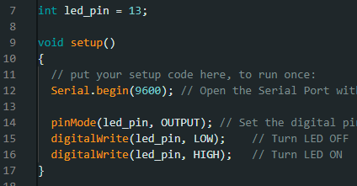
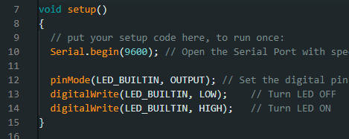
ACTIVITY 3 LIGHTBRINGER
Modify Activity 2 code (Blink for Help, SOS) to work with digital pin 13
Make a variable “led_pin” and swap it for “LED_BUILTIN” (everywhere, not only `setup()`)
Connect & Flash!
Hardware
Overview
☑ Connect External Hardware
☐ Modify SOS
☐ Send command via Serial

Slide 39
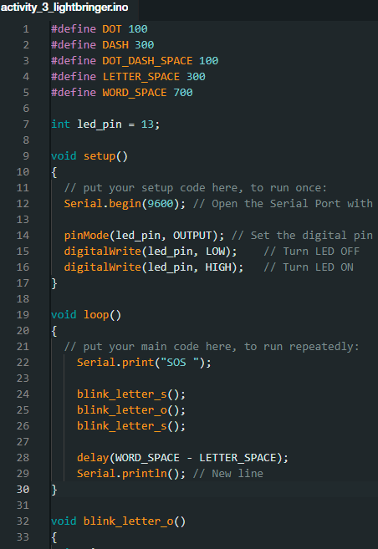
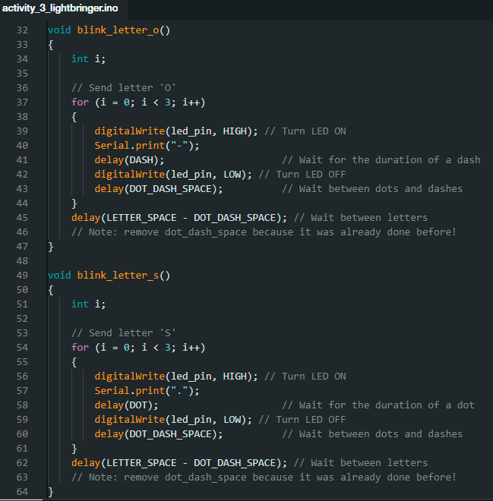
ACTIVITY 3 LIGHTBRINGER
Hardware
Overview
☑ Connect External Hardware
☐ Modify SOS
☐ Send command via Serial

Slide 40
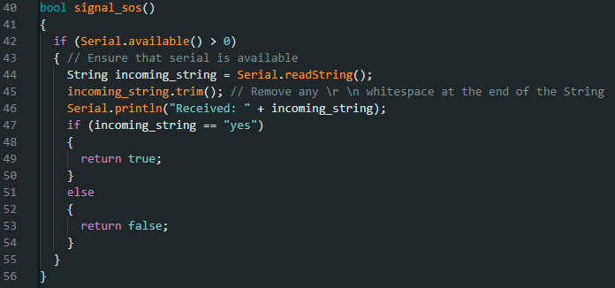
ACTIVITY 3 LIGHTBRINGER
Serial Monitor is not a pure monitor!
Use `Serial.readString()`
Hardware
Overview
☑ Connect External Hardware
☑ Modify SOS
☐ Send command via Serial

Slide 41
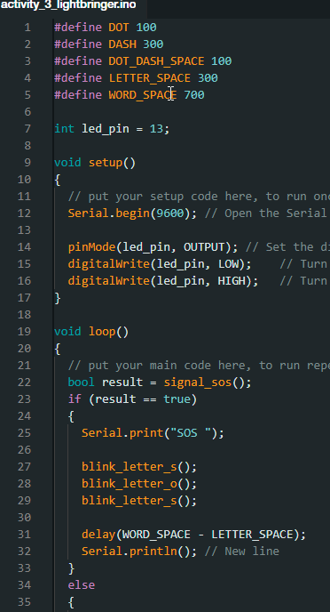
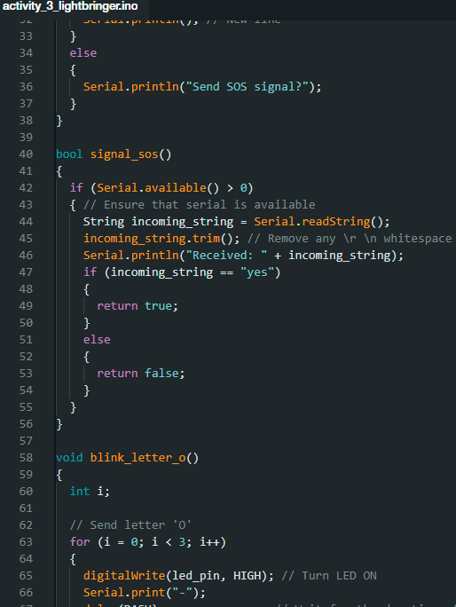
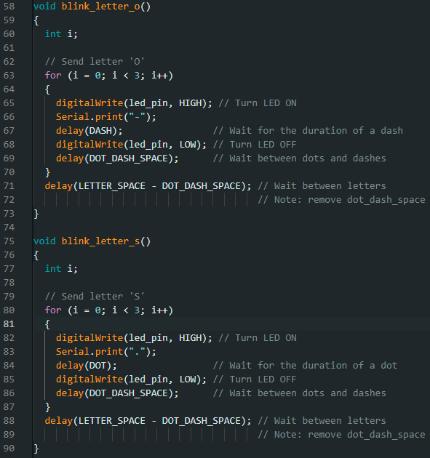
ACTIVITY 3 LIGHTBRINGER
Something like this? Flash!
Hardware
Overview
☑ Connect External Hardware
☑ Modify SOS
☐ Send command via Serial

Slide 42
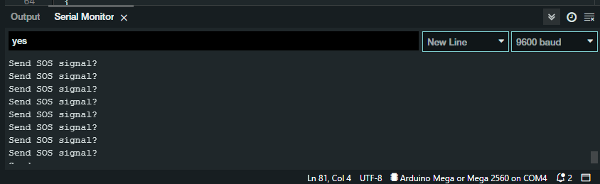
ACTIVITY 3 LIGHTBRINGER
“Ctrl + Shift + M” to open Serial Monitor
“Ctrl + Enter” to send message
Hardware
Overview
☑ Connect External Hardware
☑ Modify SOS
☐ Send command via Serial

Slide 43
ACTIVITY 3 LIGHTBRINGER
Note the option to change line endings.
How quickly is your command registered?
What happens if you change the “baud” rate?
Hardware
Overview
☑ Connect External Hardware
☑ Modify SOS
☐ Send command via Serial

Slide 44
ACTIVITY 3 LIGHTBRINGER
Hardware
Task: Blink an external LED to morse code (SOS) on command
Outcome
Schematic reading (basic)
Hardware + Software familiarization
Serial & Serial Monitor
Recap
Build your own circuits
Knowledge in documentation and/or datasheets!
Know the limitations (software and hardware)
Overview
☑ Connect External Hardware
☑ Modify SOS
☑ Send command via Serial

Slide 45
ACTIVITY 4 KNIGHT RIDER
Hardware
Task: Blink LEDs from left to right. Change speed with buttons.
Outcome
Hardware + Software familiarization
Input / Sensor
Overview
☐ More LEDs
☐ Buttons (Pull-up config) & Debouncing
☐ Code “Knight Rider” effect

Slide 46
BREAK TIME RESUME AT:

Slide 47
ACTIVITY 4 KNIGHT RIDER
Hardware
Task: Blink LEDs from left to right. Change speed with buttons.
Outcome
Hardware + Software familiarization
Input / Sensor
Overview
☐ More LEDs
☐ Buttons (Pull-up config) & Debouncing
☐ Code “Knight Rider” effect

Slide 48
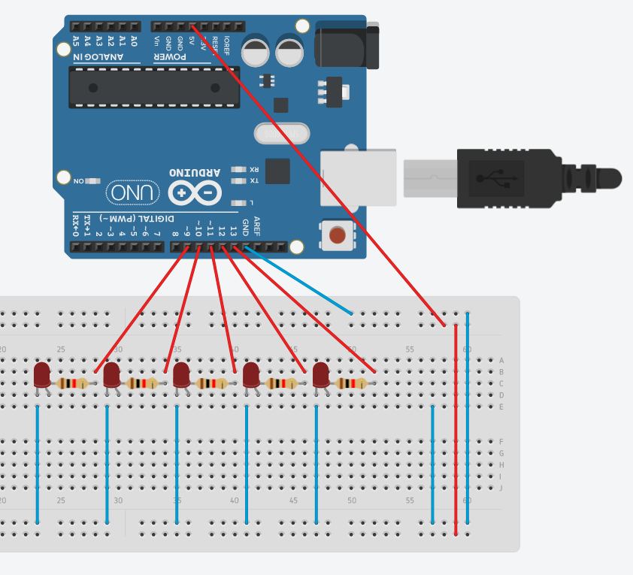
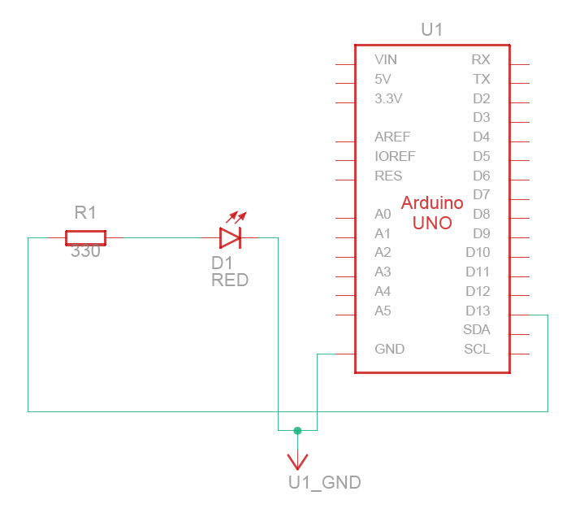
ACTIVITY 4 KNIGHT RIDER
Disconnect
Wire as per schematic
Hardware
5 TIMES
PIN D13-D9
Overview
☐ More LEDs
☐ Buttons (Pull-up config) & Debouncing
☐ Code “Knight Rider” effect

Slide 49
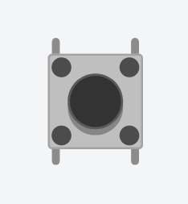
ACTIVITY 4 KNIGHT RIDER
Push button
Hardware
Always Connected
Connected when pressed
Overview
☑ More LEDs
☐ Buttons (Pull-up config) & Debouncing
☐ Code “Knight Rider” effect

Slide 50
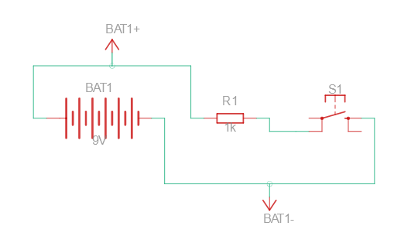
ACTIVITY 4 KNIGHT RIDER
Always Connected
Connected when pressed
Pull-up configuration
Default value is HIGH
Pressed value is LOW
Hardware
TO GPIO
Overview
☑ More LEDs
☐ Buttons (Pull-up config) & Debouncing
☐ Code “Knight Rider” effect

Slide 51
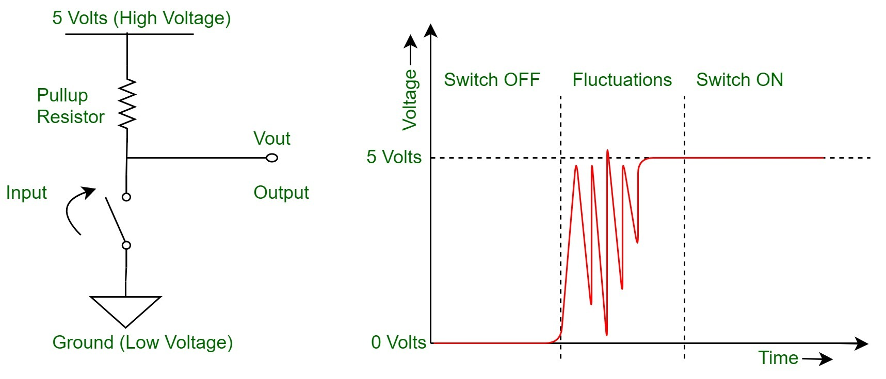
ACTIVITY 4 KNIGHT RIDER
Always Connected
Connected when pressed
Things are not perfect! ( ;_;)
Unwanted fluctuations (Aka noise)
Solution: add a capacitor to smoothen out noise
Hardware
Overview
☑ More LEDs
☐ Buttons (Pull-up config) & Debouncing
☐ Code “Knight Rider” effect

Slide 52
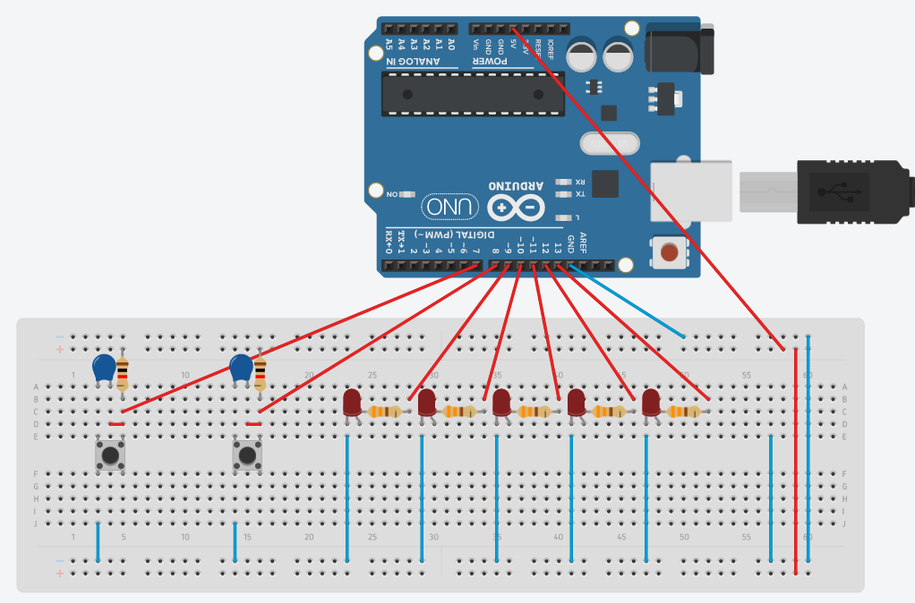

ACTIVITY 4 KNIGHT RIDER
Always Connected
Connected when pressed
Wire as per Schematic
Hardware
2 TIMES
PIN D8 – D7
Overview
☑ More LEDs
☐ Buttons (Pull-up config) & Debouncing
☐ Code “Knight Rider” effect

Slide 53
ACTIVITY 4 KNIGHT RIDER
Wiring Check
Hardware
Overview
☑ More LEDs
☐ Buttons (Pull-up config) & Debouncing
☐ Code “Knight Rider” effect

Slide 54
ACTIVITY 4 KNIGHT RIDER
Try coding a knight rider effect (single direction)
Pseudocode:
Int delay_time (has max and min values)
setup:
led pins as output
pushbtn pins as input
main:
if push btn1 only: increment delay_time
if push btn2 only: decrement delay_time
turn LED 1 ON, wait delay_time, turn LED 1 OFF
…
turn LED 5 ON, wait delay_time, turn LED 5 OFF
Hardware
5ms <= time <= 150ms
default value = 100ms
increment = 5ms
Overview
☑ More LEDs
☑ Buttons (Pull-up config) & Debouncing
☐ Code “Knight Rider” effect
Get input with `digitalRead(pin)`
Notes:
https://youtu.be/A362tbM6DVA?t=959

Slide 55



ACTIVITY 4 KNIGHT RIDER
Something like this? Flash!
Hardware
Overview
☑ More LEDs
☑ Buttons (Pull-up config) & Debouncing
☐ Code “Knight Rider” effect
Notes:
https://youtu.be/A362tbM6DVA?t=959

Slide 56
ACTIVITY 4 KNIGHT RIDER
Hardware
Task: Blink LEDs from left to right. Change speed with buttons.
Outcome
Hardware + Software familiarization
Input / Sensor
Recap
Input / Sensor are used to gather data from the world
Real life has “defects” compared to models
Overview
☑ More LEDs
☑ Buttons (Pull-up config) & Debouncing
☑ Code “Knight Rider” effect

Slide 57
QUESTIONS?

Slide 58
DEMO 1 LED/SERVO CONTROLLER
Demo | Example Application
Battery (power bank) | Wildlife tracking, Autonomous robot
Remote control (ESP8266) | Smart TV, Robotic surgery, Marine exploration
E-paper screen | Name tag, Price tag, Bus stop ads

Slide 59
DEMO 2 RASPBERRY PI
Raspbian on raspberry pi
Retro game arcade
Web server

Slide 60
WHAT NEXT?
Buy your own?
Polling vs Interrupts
ESP8266? Zigbee? Bluetooth? WiFi?
IoT benefits and dangers
Slides, files, source code available:
https://github.com/MrTanoshii/Intro-Embedded-Systems

Slide 61
QUESTIONS?

Slide 62
THANK YOU
Tsen Chee Vincent LEUNG YIN KO
vincent.leungyinko@gmail.com
Slides, files, source code available:
https://github.com/MrTanoshii/Intro-Embedded-Systems

